Slide 1

ROLE OF NUTRITION IN SPORT
Francesco Di Martino Comaschi

Slide 2
“Good food choices don't make up a mediocre athlete a champion, but wrong foods choices can prevent the possible champion to realize his / her maximum potential "[Ron Maughan]

Slide 3
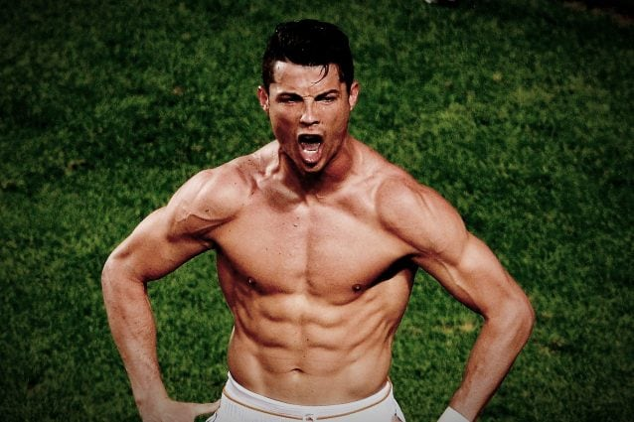
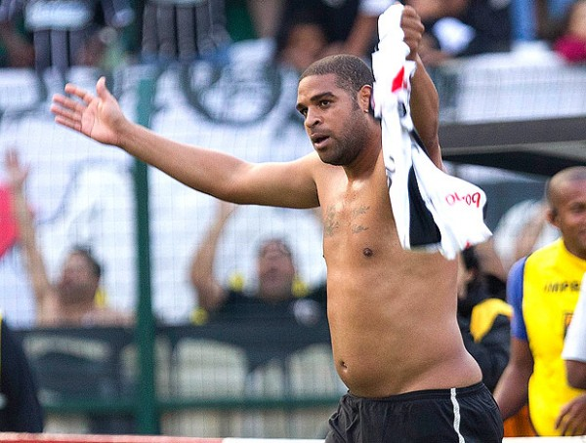
Ronaldo vs Adriano
36 years old
30 years old

Slide 4
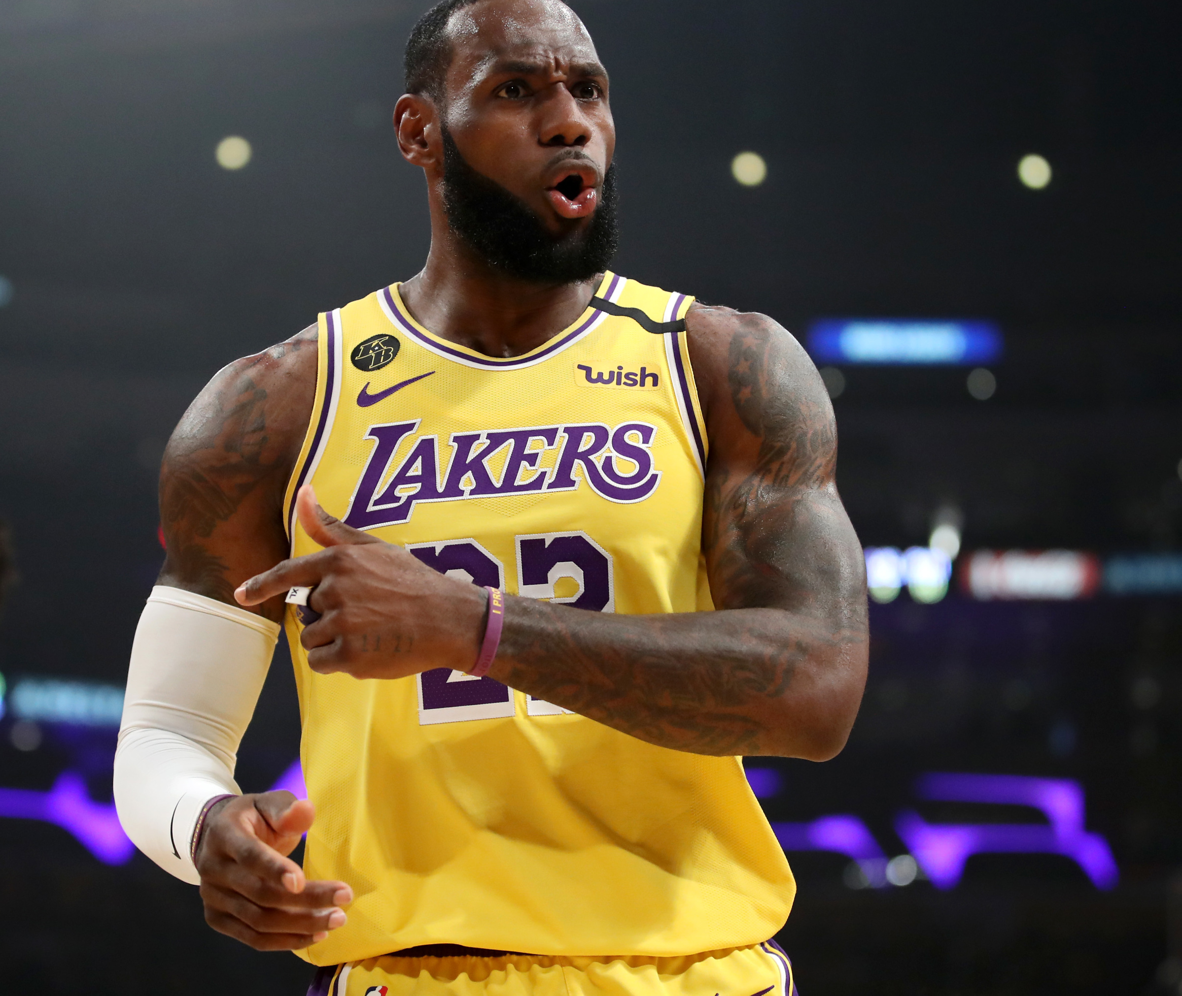
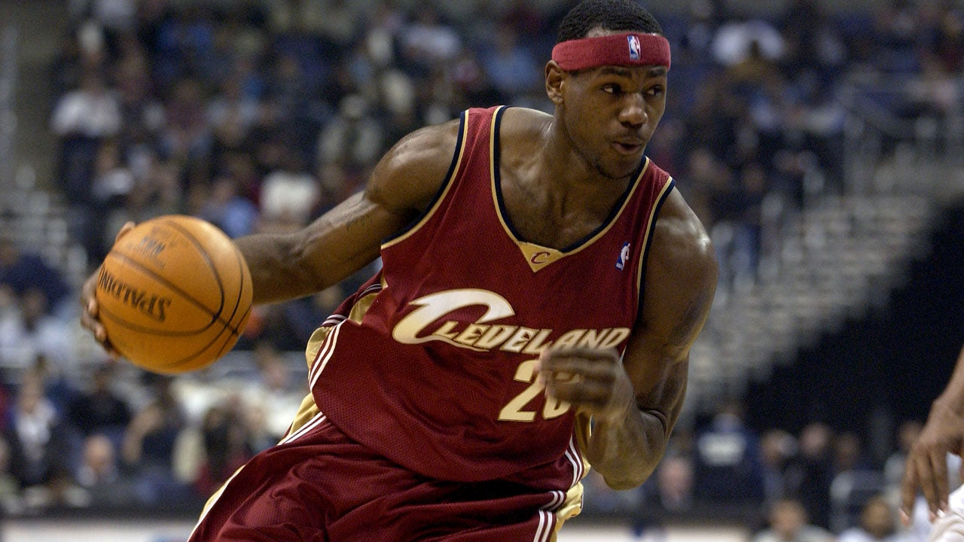
Lebron james
19 Years Old
20.9 points 5.5 rebounds 5.9 assists 1.6 steals
36 Years Old
25.8 points 8.1 rebounds 8.0 assists 1.1 steals

Slide 5


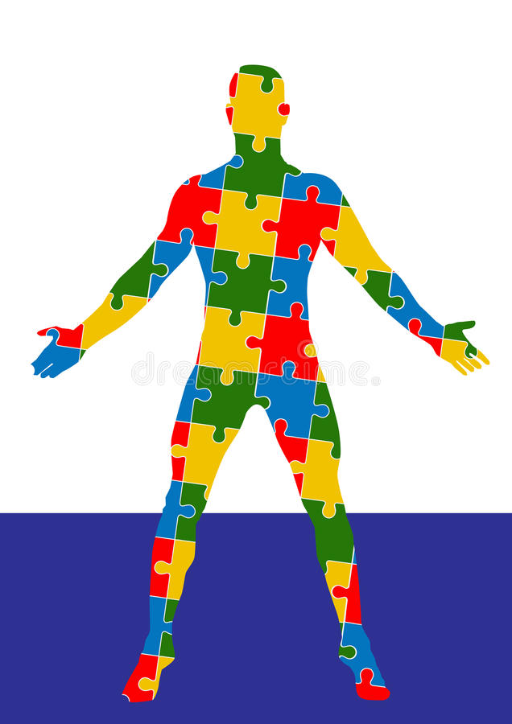


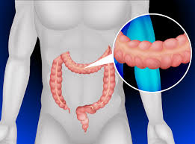
Nutritional FACTORS THAT INFLUENCE SPORT PERFORMANCEs
Carbohydrates
Energy Balance
Proteins
Minerals & Vitamins supplements
Gut
Sleep

Slide 6

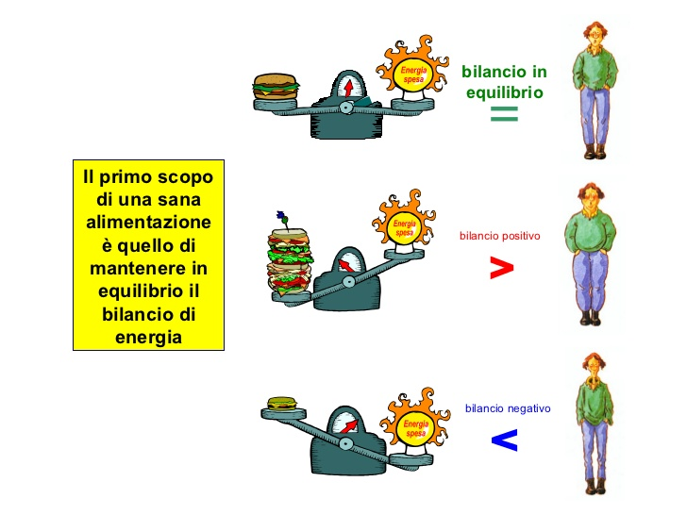
Energy Balance
It is the balance of calories consumed through eating and drinking compared to calories burned through physical activity.
Foods
Drinks
Supplements
Basal metabolic rate (BMR).
Digestion
Physical activity
Age
Sex
Muscle mass
Genetic factors

Slide 7
Energy Balance
Negative balance
Balance = 0
Positive balance
Lack of energy.
Risk of nutrients deficiencies.
Used for some athletes that have to be in a restricted weight (boxers).
Gain of weight (mostly fat).
Good for some athletes that are underweight.
Optimal conditions in most of the sports.

Slide 8

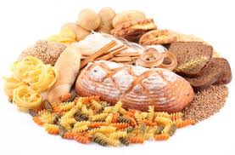

Carbohydrates intake
Carbohydrate are the most important energy source in almost all sports. In our body they are stored in our blood (Glycaemia) , liver and muscles (as glycogen, the most used during sport activity). The storage of carbohydrates in our body is limited so it is important to have a constant intake of this nutrient without exceed the amount.
Complex carbohydrates
Simple sugars
Simple sugars have an high impact in our glycaemic response, causing a fake felling of satiety and fat mass synthesis.
Wholemeal pasta, bread, rice, quinoa ext. are the best carbohydrates sources. They should be used before and after a sport event.

Slide 9
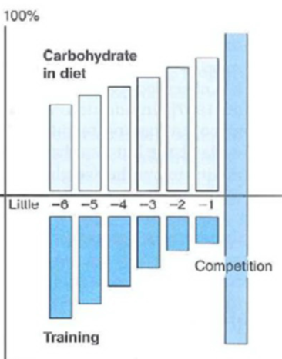
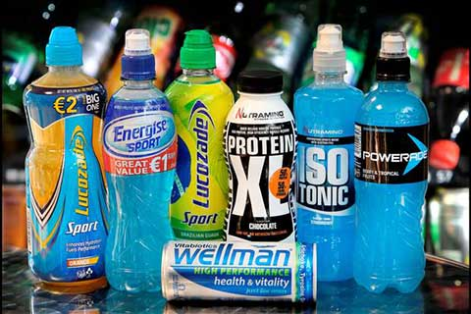
Timing of carbohydrates intake
It is important to increase gradually the carbohydrates intake.
Days before the events
Hours before the events
The pre-event meals should be served few hours in advance and reach of complex carbohydrates.
For sport events longer than 30 minutes, the consumption of sport drinks is advised to avoid drops in the glycaemic.
During the events
After the events
Recovery is very important, a snack in the first 30 minutes helps glycogen synthesis.

Slide 10

Protein's intake
Proteins are like the '' building blocks '' of our body, especially our muscles, but they can also be used as a form of energy. The ideal quantity to consume them daily is linked to the body weight of a single individual and his physical activity; the higher they are, the higher the need for protein.
Sedentary people 0,8 g per kg/day.
Athletes 1,2-1,4g per kg/day.
Professional Athletes 1,6-1,7 g per kg/day.
Proteins from, vegetable sources, have a lower amounts of essential ammino acids and the presence of elements that may block their absorption. For people, who have a vegan diet, is advised to increase the protein intake of 10/15%.

Slide 11
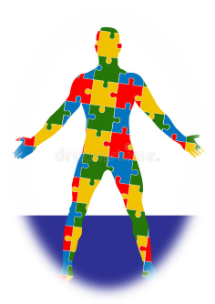

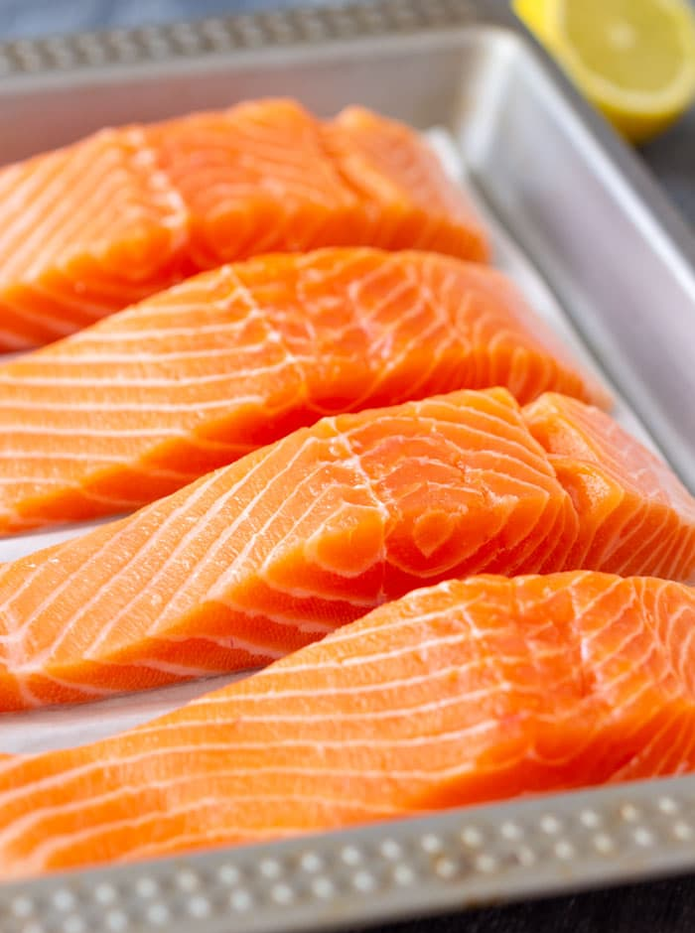
Animal protein sources

Slide 12
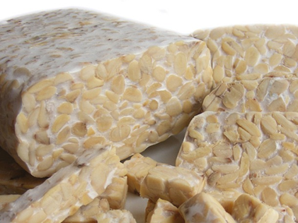
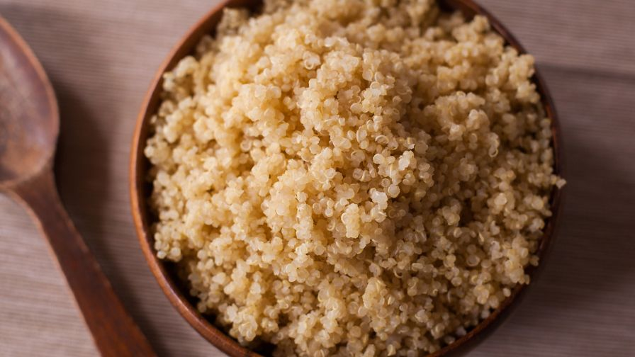
Protein Vegetable sources

Slide 13

Vitamins and minerals supplements
Vitamins and minerals are considered micronutrients. They are not used as an energy source but they are part in many functions in our body.
Most of the Vitamins and minerals cannot be synthetized in our body, so we have to assume in our diet.
In case of our diet presents a lack of one or more of these micronutrients, an adeguate supplementation should be considered.

Slide 14
Most common and less desired micronutrient deficiencies in sport
Present in our blood cells and muscles, helps the oxygen carrying.
A lack , leads to a tiredness felling or more serious diseases.
Avoid consumption of coffee and teas during meals, vitamin C helps iron absorption
Iron
Zinc
Important in the protein synthesis, thus in the muscle growth .
Lack of zinc is often overlooked in favor of calcium and iron.
Common in vegans, vegetable sources are beans, wheat, pumpkin seeds, oats.
Vitamin D
Important for bone health, calcium absorption and other physiological processes.
Consider the supplementation during wintertime.
Calcium
Principal element of or bone.
For vegans, millet, fortified soy (as tempeh), or fortified tofu.

Slide 15


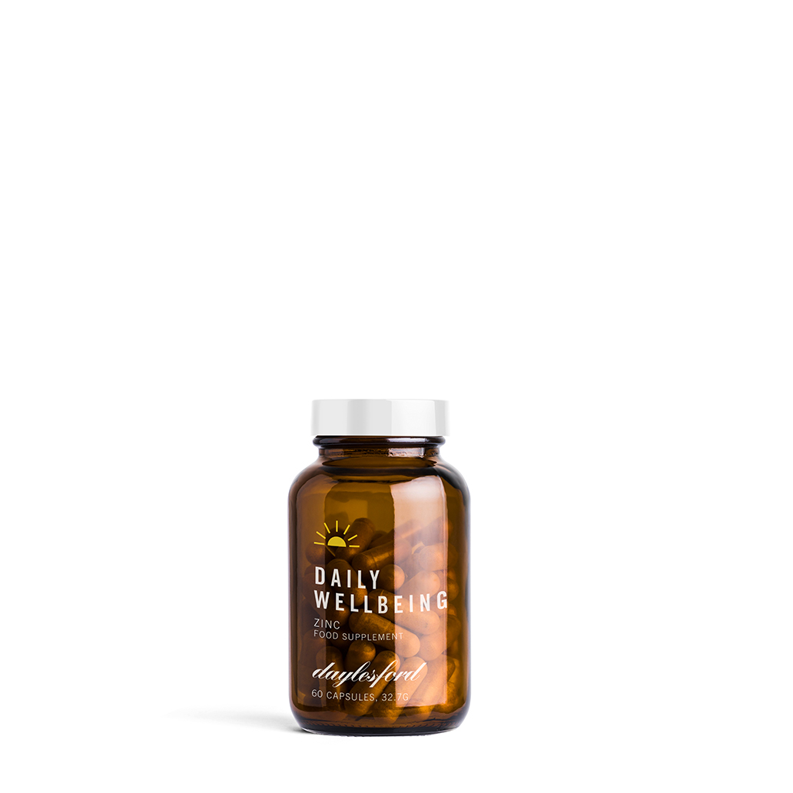

Some Daylesford products

Slide 16
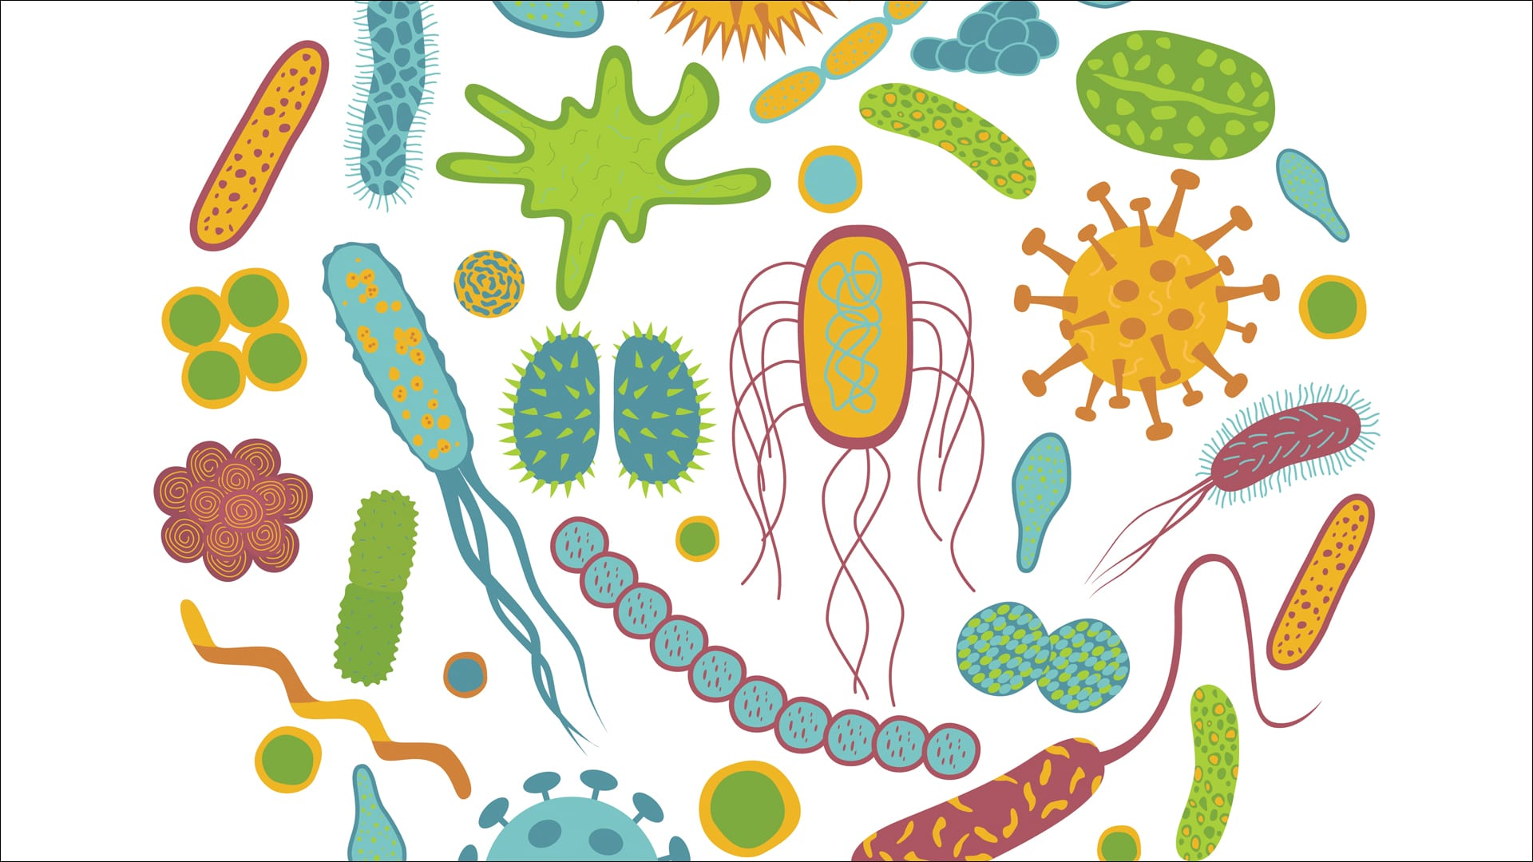
Gut microbiome
The gut microbiome consists of the collective genome of microbes inhabiting the gut (symbiotic and pathogenic) including bacteria, archaea, viruses, and fungi.
Control digestion.
Benefits in the immune system
May contribute to weight gain, high blood sugar, high cholesterol and other disorders.
Protects pathogen bacteria.
Synthesis of K group vitamins.
Intensive physical activity may stress our Gut causing pain, cramps, nausea or
diarrhea. .

Slide 17


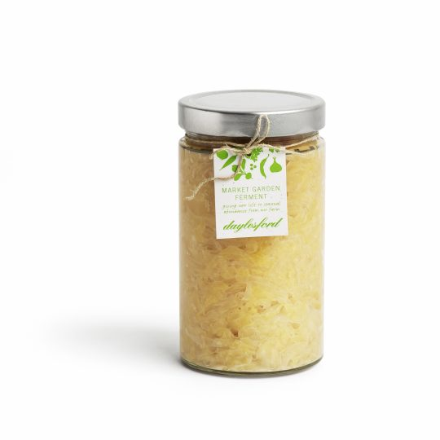

Some Daylesford products

Slide 18

Sleep
Resting period is important as much the training. It is important to sleep about 7/8 and following the natural time .
A lack of sleep can bring:
Stress
Decrease of muscle mass
Increase of fat mass
Higher Glycaemic response
Lower metabolization of micronutrients as vitamins and minerals.

Slide 19

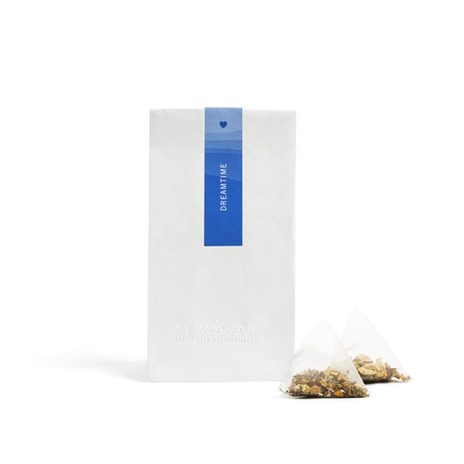


Some Daylesford products

Slide 20

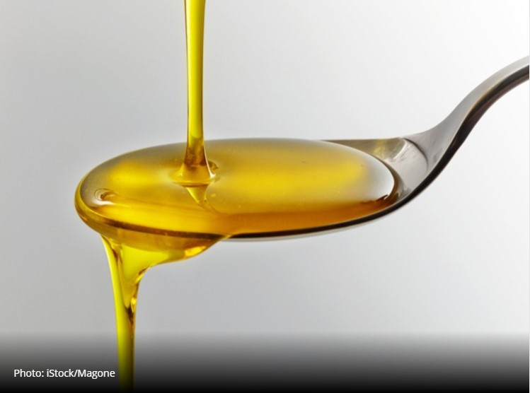
Other factors
Heat Stress
Immune system
Hydration
Fats
Doping (in a negative way)
Some videos about the role of nutrition in sport:
https://www.youtube.com/watch?v=2iriejQTgF0
https://www.youtube.com/watch?v=DBEJlgXBNzY

Slide 21

T
Thank you for your attention

